Slide 1
Briefing on: Waitangi Tribunal health kaupapa report – WAI 2575 (stage one)
Arguably this report is the most important report on Māori health in decades and a must-read for those teaching health practitioners and undertaking health research. This interactive briefing will overview the report and provide expert commentary via the Taupua Waiora team.
Waitangi Tribunal - “We recommend that the Crown acknowledge the overall failure
of the legislative and policy framework of the New Zealand primary health
care system to improve Māori health outcomes”
1-2pm Tuesday 16th July 2019
at MB317 at AUT South or AE114 at AUT North or via https://aut.zoom.us/j/3584221357
For more information contact heather.came@aut.ac.nz

Slide 2
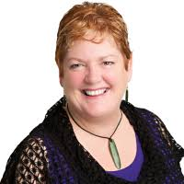
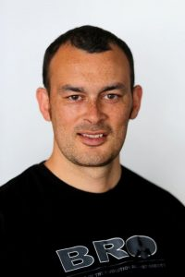
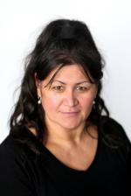
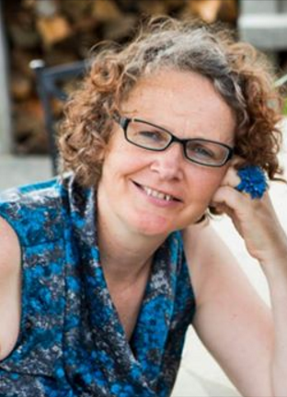
The presenters
Assoc Prof Jacquie Kidd
(Ngāpuhi) has a mental health nursing background who joined Taupua Waiora in January this year.
Jacquie has been collaborating with Māori communities for over 10 years to highlight the gaps in health service provision and build equitable responses to Māori needs and aspirations, especially in relation to cancer.
Her work takes a dual focus of improving the cultural health literacy of organisations while also building on the strengths of whānau, hapū and iwi to improve outcomes.
Dr Isaac Warbrick.
(Ngāti Te Ata, Te Arawa, Ngā Puhi) is an exercise physiologist, and Director of Taupua Waiora. Much of his research is conducted at the interface between biomedical, lab-based, and indigenous approaches to research. Isaac is currently leading projects and collaborating with researchers in a variety of fields including exercise physiology, Māori health, epigenetics, men’s health, racism and health, and the use of traditional knowledge, such as the maramataka, on Māori health.
Dr Alayne Hall
(Ngāti Whatua, Te Rarawa, Tainui) Alayne is a post-doctoral researcher with Taupua Waiora with a background in Child and Māori Mental Health. She is a registered psychotherapist and a founding member of Waka Oranga – National Collective of Māori Psychotherapy Practitioners (NCMPP). Alayne is a member of the Health Quality Safety Commissions Child Youth Mortality Review Committee and Nga Pou Arawhenua. Alayne’s interest in research is to develop evidence based Māori and Indigenous interventions to reduce violence and issues related to historical, intergenerational and complex trauma.
Dr Heather Came-Friar
(Tangata Tiriti) Heather has worked for 25 years in health promotion, public health and/or Māori health and has a long involvement in social justice activism in Aotearoa New Zealand. She currently embraces life as an activist scholar. Her research interests include institutional racism, anti-racism, critical policy analysis and the application of te Tiriti o Waitangi.
Heather is a founding member and co-chair of STIR: Stop Institutional Racism, a fellow of the Health Promotion Forum, and an active member of Tāmaki Tiriti Workers.

